Slide 1
Challenges in the Development of Ocean Coupled, Operational Hurricane Forecast Model
at National Weather Service (NWS)
Hyun-Sook Kim
Environmental Modeling Center (EMC)
National Centers for Environmental Prediction (NCEP)
National Weather Service (NWS)
NOAA
College Park, MD 20740
Friday April 10, 2015

Slide 2
Outline
Challenges
Tropical Cyclone
The Hurricane Weather Research and Forecast system (HWRF)
Comparisons of North Atlantic Hurricane Forecasts between HYCOM and POM coupling
Comparisons of Western North Pacific Typhoon Forecasts between HYCOM coupling and non-coupling
Introduction of Ocean Model Impact Study
Summary

Slide 3
Challenges
Current operational Hurricane Weather Research and Forecast System (HWRF) coupled to POM (since 2007)
HYCOM (experimental) to be in the operational in 2016
Generate 5-day numerical guidance products on time, 4 times per a day, for NHC/JTWC/CPHC forecasters
In 2015, expanding to Indian Ocean and Southern Hemisphere
Triple nested, w/ model grid resolution, 18-6-2 km; 61 levels
Numerical Integration step, 30 sec.
7 storms at maximum per cycle.
Ocean Model: 1/12-degree, 42 levels
➔ Computer resources (competing with 25 other operational models)
Goal is to produce robust and skillful model guidance.
However, conflicts exist between having right physics (including ocean) and producing on-time better guidance.

Slide 4
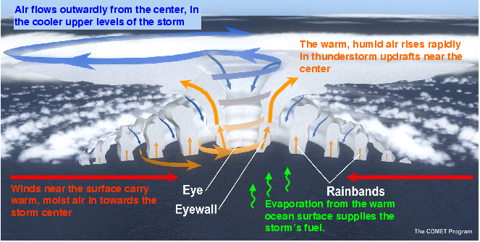
Tropical Cyclone
Called by
Hurricane/Typhoon/Cyclone
Characteristics
Multi-scale processes in spatial and time, ranging from the environmental O(km)/O(decadal) to the microphysical scale O(µm)/O(second), interacting independently and/or collectively.
The importance of air-sea interactions.
PBL height
Edited by hsk

Slide 5
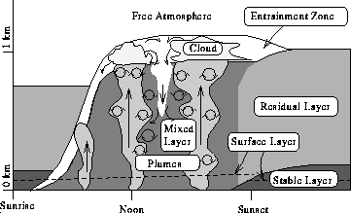
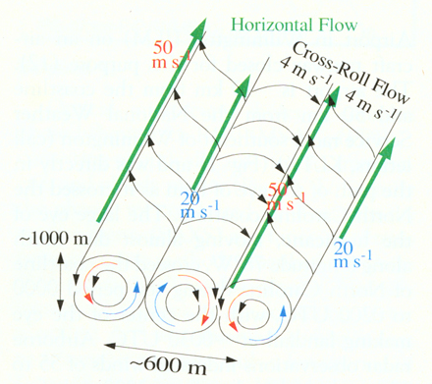
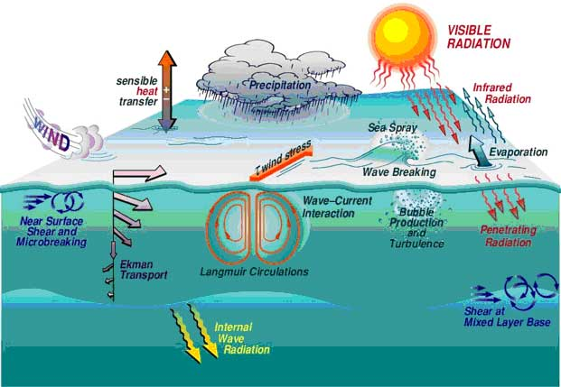
At Least What is known at PBL and Ocean Upper Layer
Vortex
Roll
Wurman and Windslow
Science, 1998
From Here
From Here
Entrainment
ESRL (edited by hsk)

Slide 6
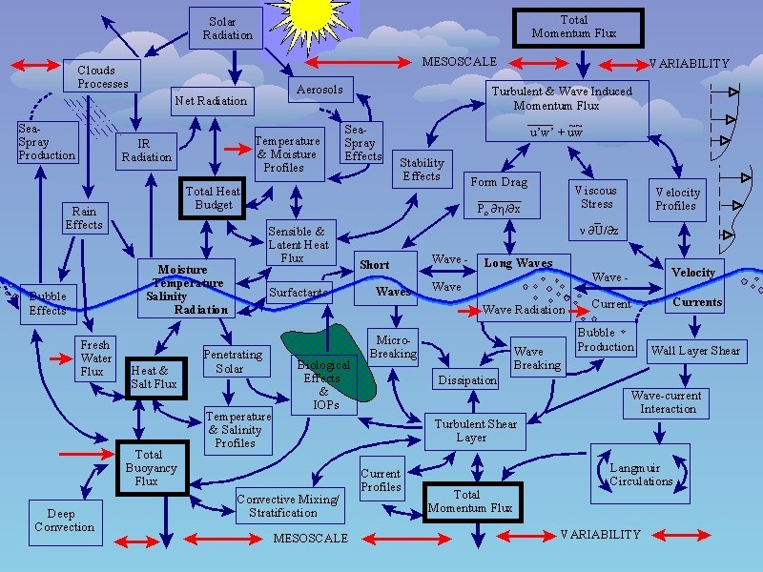
Air-Sea Interface
Heat Budget + Processes
Momentum Budget + Processes
& From Here
Air
Sea
http://www.whoi.edu/science/AOPE/dept/CBLASTmain.html

Slide 7
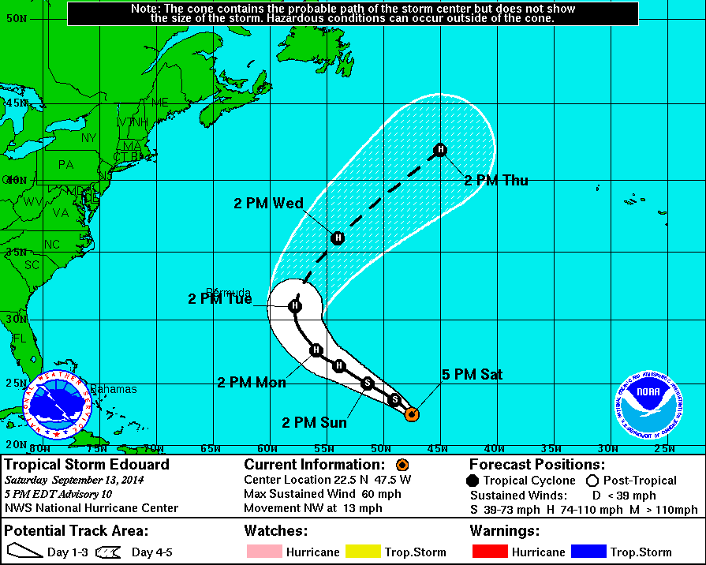
NHC Official Forecast Advisory
e.g., Hurricane Edouard (2014)
To Here

Slide 8
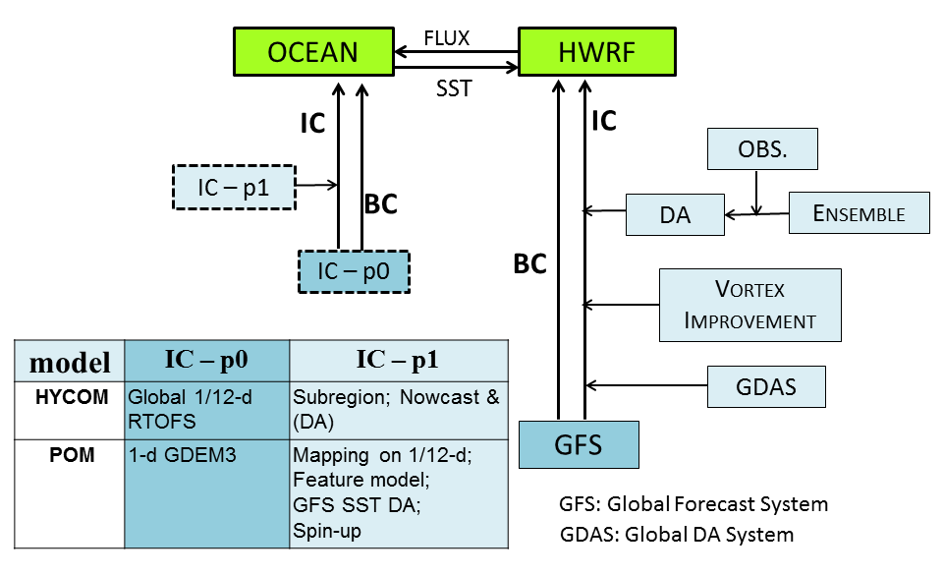
The Hurricane Weather Research and Forecast System (HWRF)
Ocean Component in HWRF:
North Atlantic – 3D POM since 2007
Eastern North Pacific – non-coupling before 1D POM (2011), 3D POM (2012 -)
Western North Pacific – non-coupling (2012 - )

Slide 9
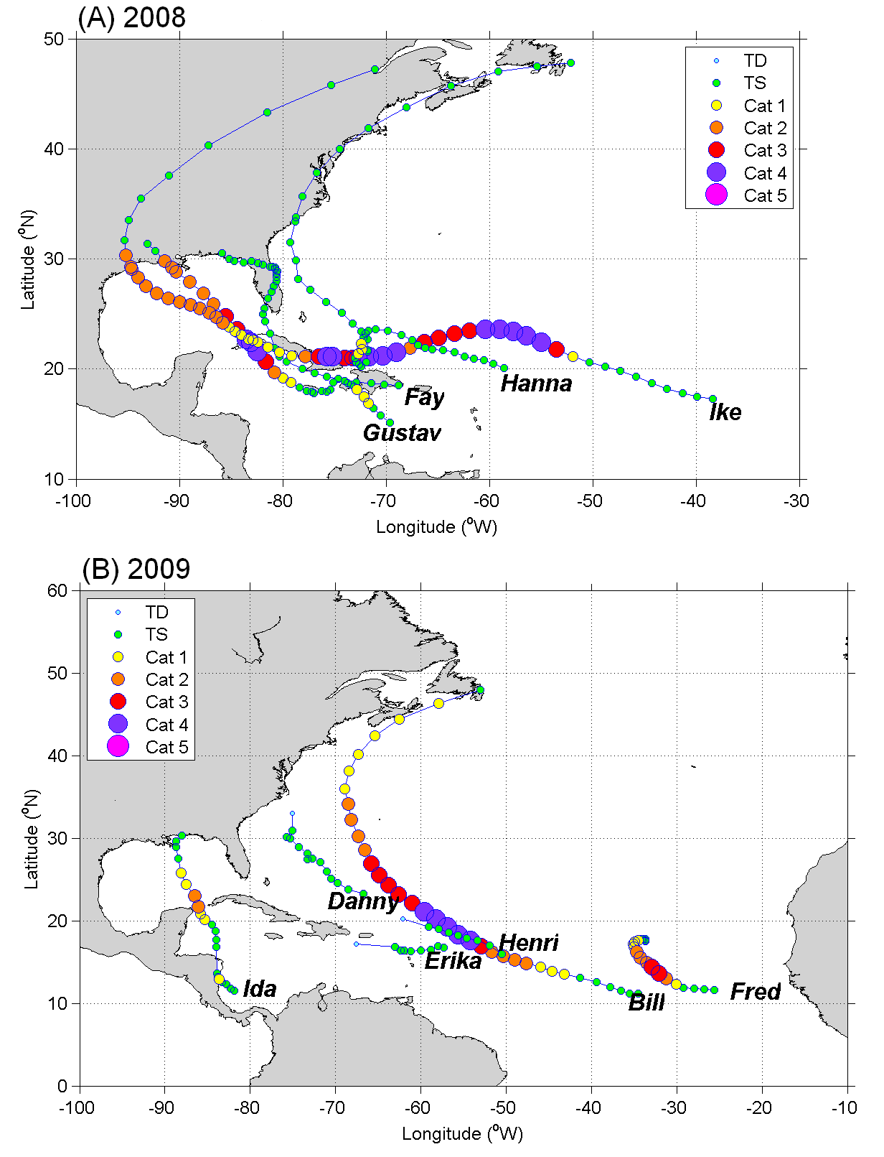
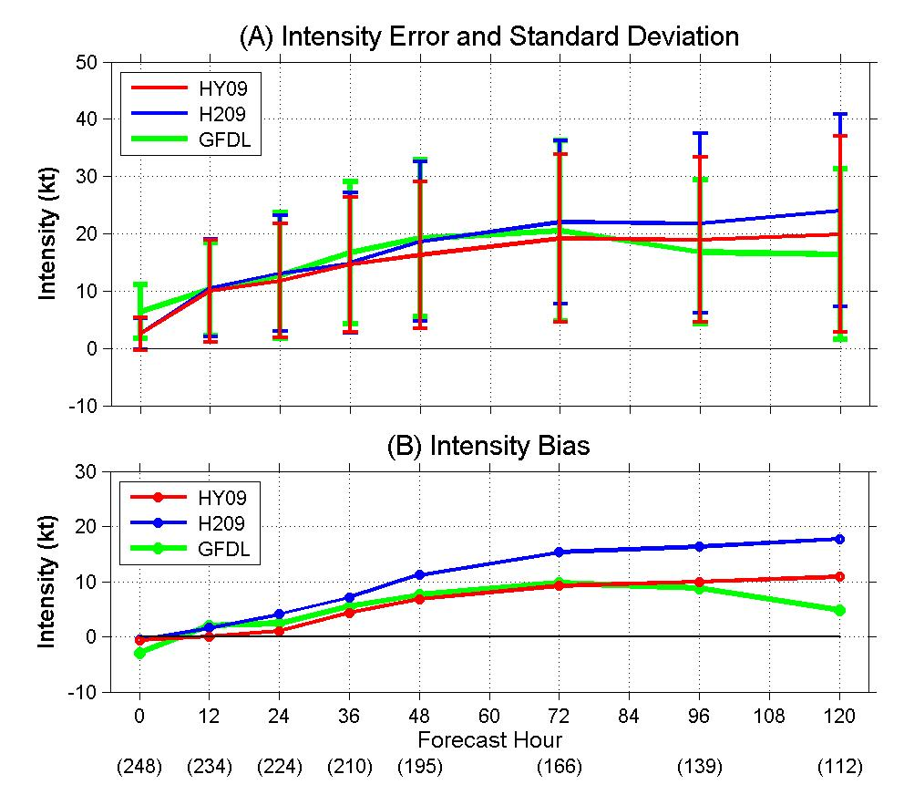
HYCOM coupling vs. POM coupling
2008 and 2009 North Atlantic Hurricane Forecast Comparisons
(Kim et al. 2014)
HYCOM coupling
➔ Reduced intensity error by ~13%, and bias by ~43%

Slide 10
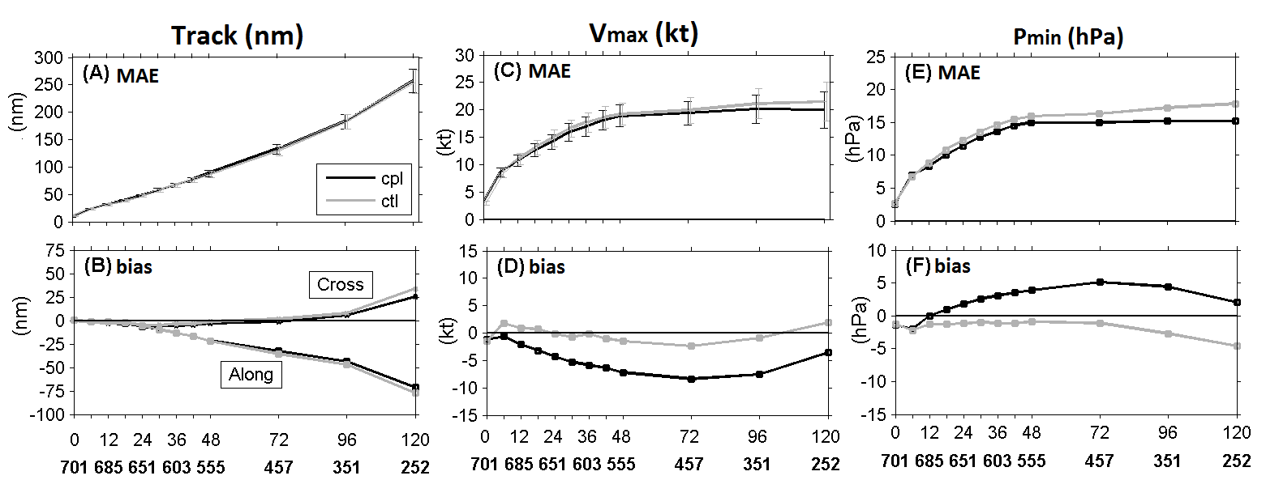
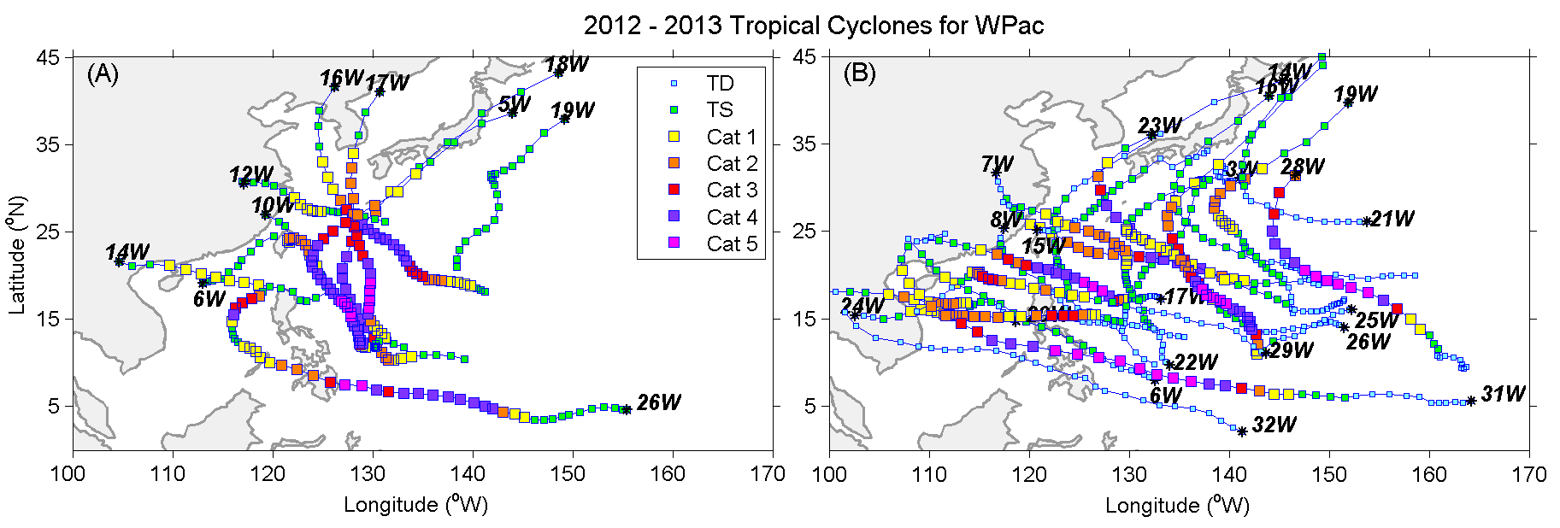
HYCOM Coupling vs. Non-Coupled
2012–2013 Western North Pacific Typhoon Forecast Comparisons
(Kim et al. 2015, in review)
cpl (dark):
HWRF-HYCOM
(exp.)
ctl (light):
non-coupled HWRF
(exp. op. for JTWC)
Verification
HYCOM Coupling
non-balance gradient winds
air-sea interaction reconsidered
revisit Initial Conditions for Atm. & Ocn.
10 TCs
21 TCs

Slide 11
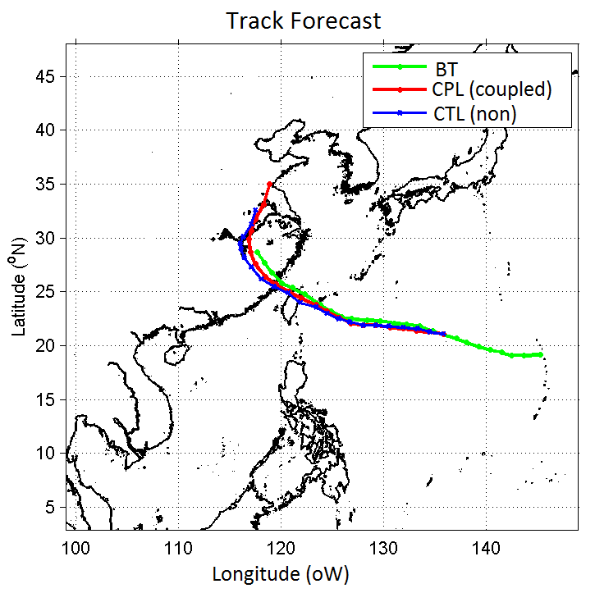
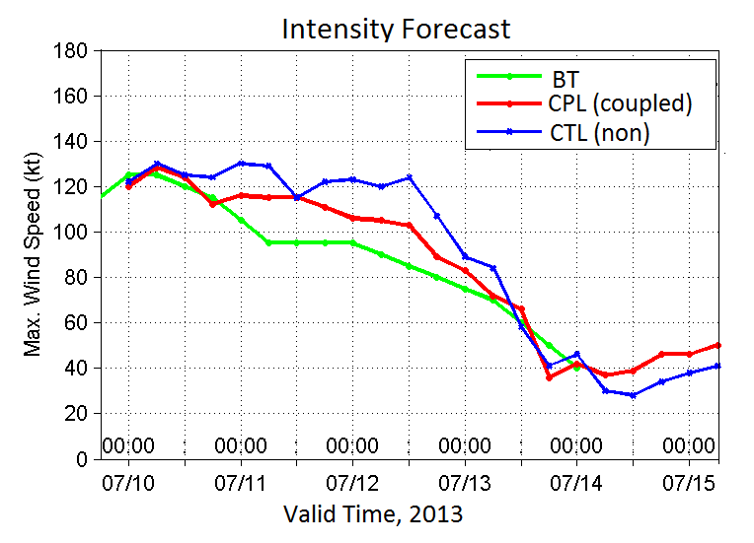
Comparisons of Forecasts
Example: Soulik (07W) July 7 to 13, 2013
IC=2013/07/10 00Z
Landfall
HYCOM coupling
Track – similar/slightly better
Intensity – reduced by <20 kt

Slide 12
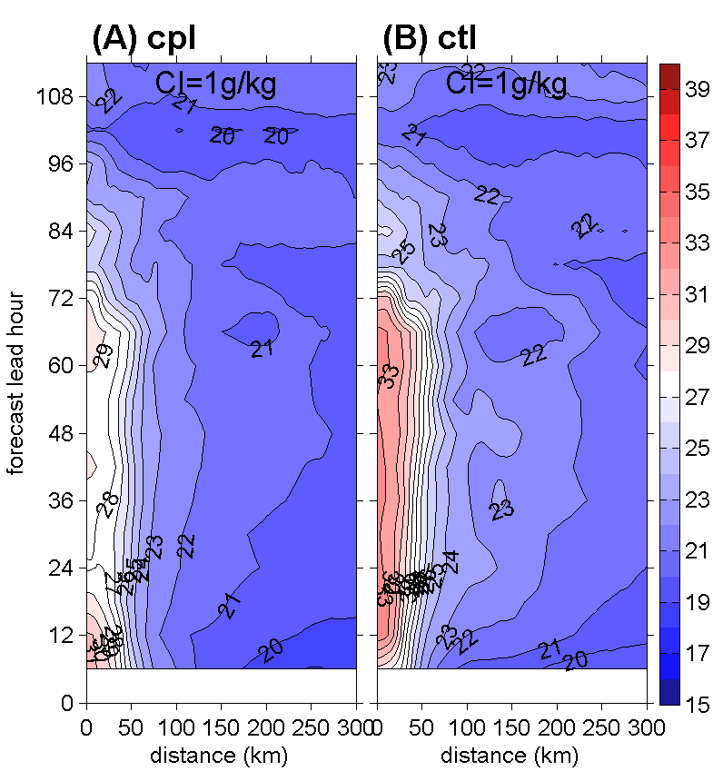
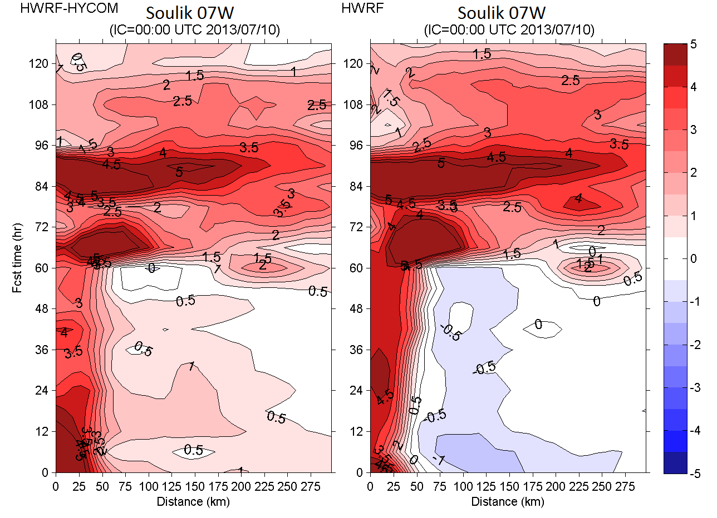
Heat Sources
Specific Humidity (left panels) at the Lowest Model Layer and
Air-Sea Temperature Differences (right panels)
Soulik (2013) IC=2013/07/10 00Z
Specific Humidity
(Latent Heat Flux)
Air-Sea Temperature Difference
(Sensible Heat Flux)
Azimuthal average from the storm center out to 300 km

Slide 13
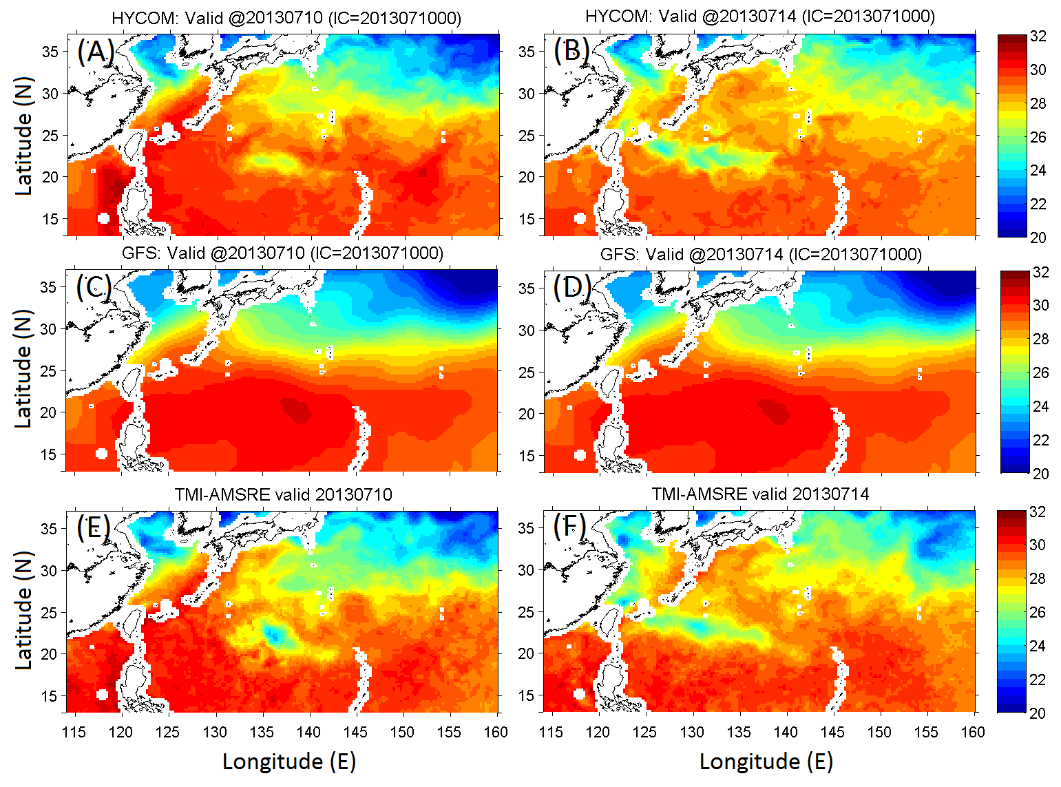
Comparisons of SST Cooling
Initial Condition
Day 5 SST
HYCOM
SST cooling O(<4ºC)
GFS
TMI-AMSRE
Improvement of Intensity Forecasts should include SST feedback.
Atm. ➔ the air-sea interaction parameterization and IC.
Ocg. ➔ IC better representing the upper structure (MLD, dT/dZ, mixing physics).

Slide 14
The Hurricane Forecast Improvement Project (HFIP)
Ocean Model Impact Tiger Team (OMITT) 2015-2016
Hyun-Sook Kim (chair) and George Halliwell (co-chair)
and
~20 scientists from 12 institutions
Specific Charge to the Current Tiger teams
Determine the benefit of coupling ocean model of various complexity to operational hurricane atmospheric model, by assessing the impacts of the ocean components on the HWRF forecasts and the sensitivity of these impacts on air-sea interface, surface flux, and atmospheric parameters.
No change in sea surface conditions from the initial state
Simple 1D subsurface mixing model
Various complexities of 3D ocean models
Impact of various fluxes on hurricane prediction such as waves, sea spray etc.
Process will include:
Agreement among team participants on:
Models to be compared – HYCOM, POM and NCOM
Methods to compare results – build metrics
Storm selected – 2014: Edouard, Gonzalo, Iselle, Julio and Fengshen; 2013: Soulik; and 2012: Isaac
Prepare a report to be presented at the 2015 HFIP annual meeting

Slide 15
Hurricane Field Activities
Comprehensive, Multi-Institutional Collective Efforts:
Coupled Boundary Layers/Air-Sea Transfer (CBLAST) (2004) – air-sea interaction flux at winds < 30 m/s
Interaction of Typhoon and Ocean Project (ITOP) & TCS-10 (2010) – air-sea interaction flux at winds ≥ 30 m/s (http://p3rd.as.ntu.edu.tw/2008/data/doc/presentations/20101104/5.4_Jim_Moore.pdf)
Hurricane Research Division:
Hurricane Field Program from 1997 changed to
Intensity Forecast EXperiment (IFEX) from 2005 –
Ocean Research Field Campaign (varies year by year)
Ocean Obs. – AXBTs, SeaGliders, AXCP, AXCDP, etc
Special Program supported by the Disaster Relief Act (a.k.a. Sandy Supplemental) fund (2014 – 2015).

Slide 16
Summary
Lack of
Research
Air-sea parameters, in particular, are heavily tuned to non-coupling.
HWRF IC/BC are provided from GFS whose SST is non-eddy resolving and persistent per a 24-h period (no diurnal variation).
Validation Activity
Observations for Validation
Computation Power as higher resolution, multi-moving nest domains, and expanding to global application.
Focusing on Developing/Updating Model Each Year
Requests from NHC
Better forecast products – Competing against implementing right physics
Labor intense
Tests & Experiments for upcoming version (yearly)
e.g., O(2000 cases) were simulated, which cover the 2011-2014 seasons
Real-time exercise in parallel w/ operational and experimental systems.

Slide 17
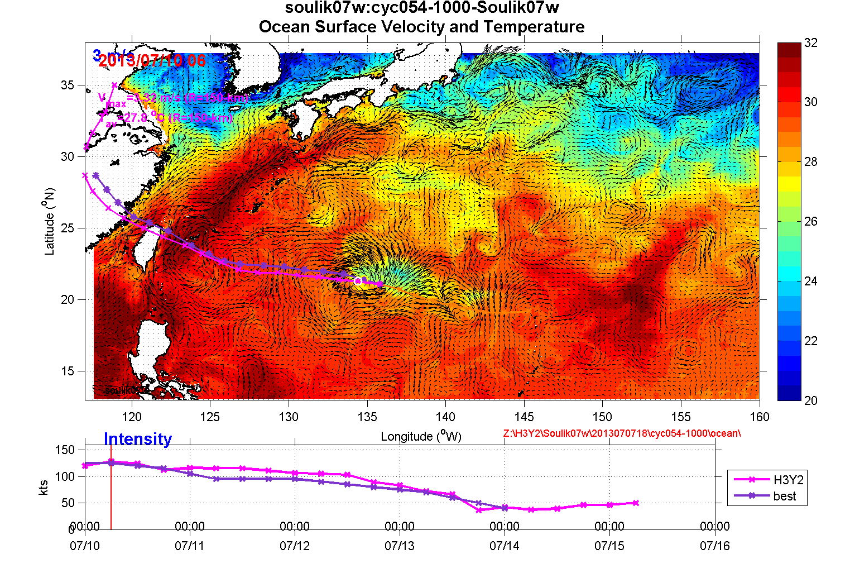
Animation:
Coupled HYCOM-HWRF Simulations
Soulik (2013)
7/8 – 7/13
HYCOM-HWRF simulations
SST &
ocean surface currents
for a 5-day
Magnitude of SST cooling is
O(8ºC)

